Slide 1


Session 3

Slide 2
Revision
1.Operators
2.User input
3.Comment line

Slide 3
Control Structure or conditional statement
Decision Making: Conditional statements allow programs to make decisions based on various conditions or inputs.
If Statement
If else Statement
Elif statement(else if)
Nested if

Slide 4
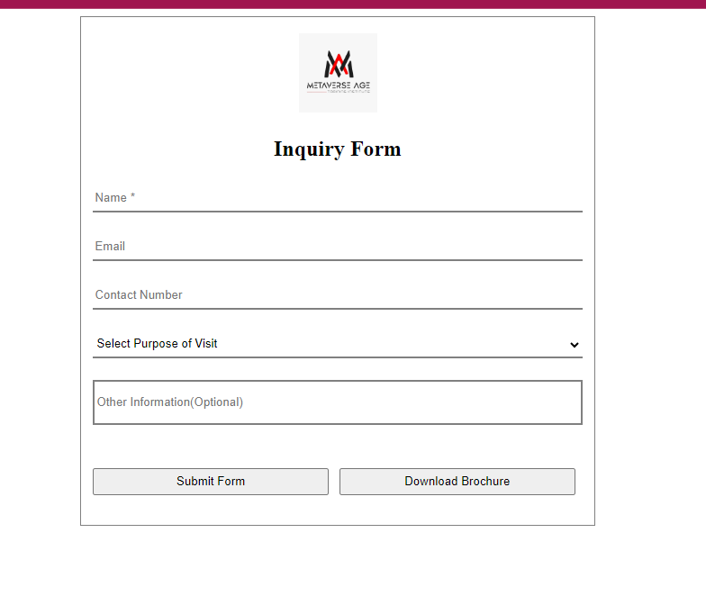
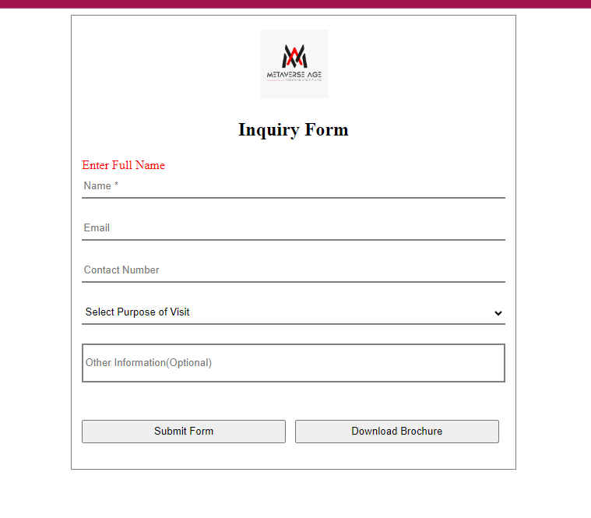
When we use conditional statement real time
Submit button coding
if (textbox.text==Empty)
print(“Enter Full Name”)

Slide 5
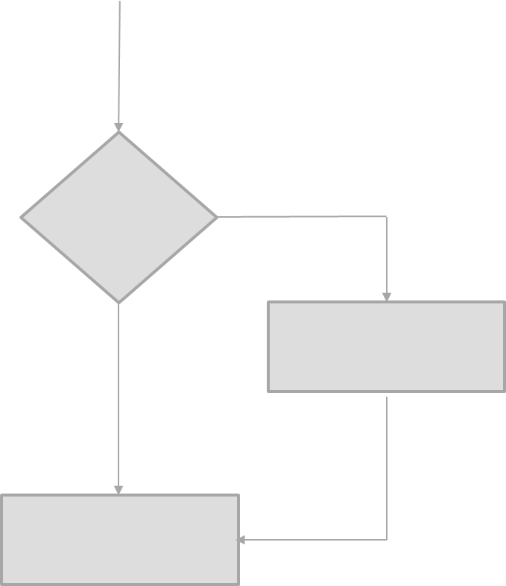
If Statement
In a Python program, the if statement is how you perform this sort of decision-making. It allows for conditional execution of a statement or group of statements based on the value of an expression.
Condition
true
Statements
False
Statements after if

Slide 6
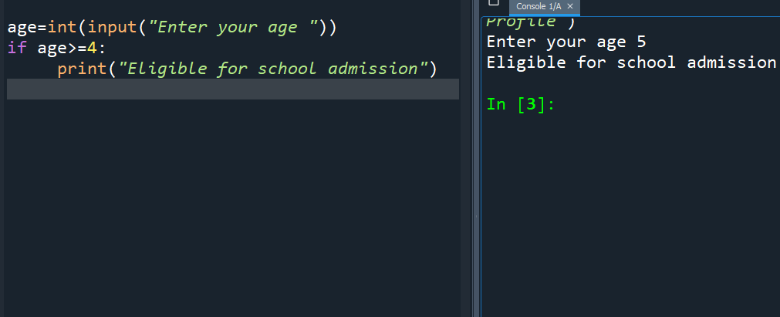
If Statement
age=int(input(“Enter your age “))
If age>=4:
print(“Eligible for school admission”)

Slide 7
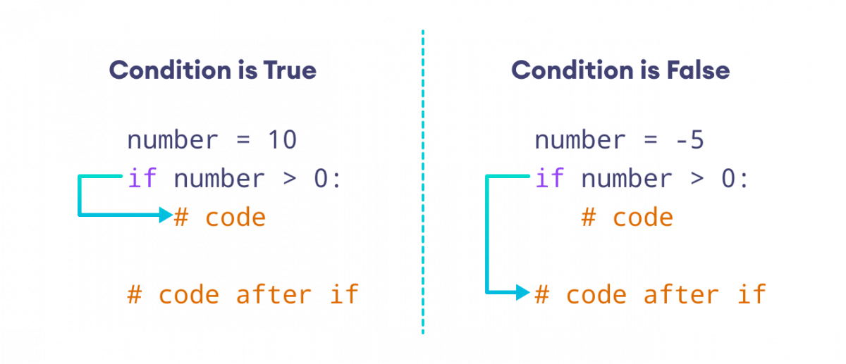
Why if else

Slide 8
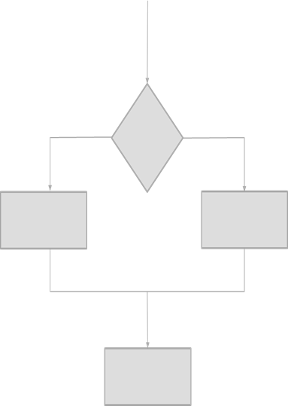
If Else Statement
The if-else statement in Python is used to control the flow of the program based on a condition. It has the following syntax: # Execute this block if condition is True # Execute this block if condition is False For example: print("x is greater than 5") print("x is not greater than 5")
False
Condition
true
Statements if false
Statements if true
Statements after if

Slide 9
Coding
name=input("Enter your name")
age=int(input("Enter your age"))
if age>=18:
print(name,"age is",age,"Eligible for Driving License")
else:
print(name,"age is",age,"Not Eligible for License ")

Slide 10
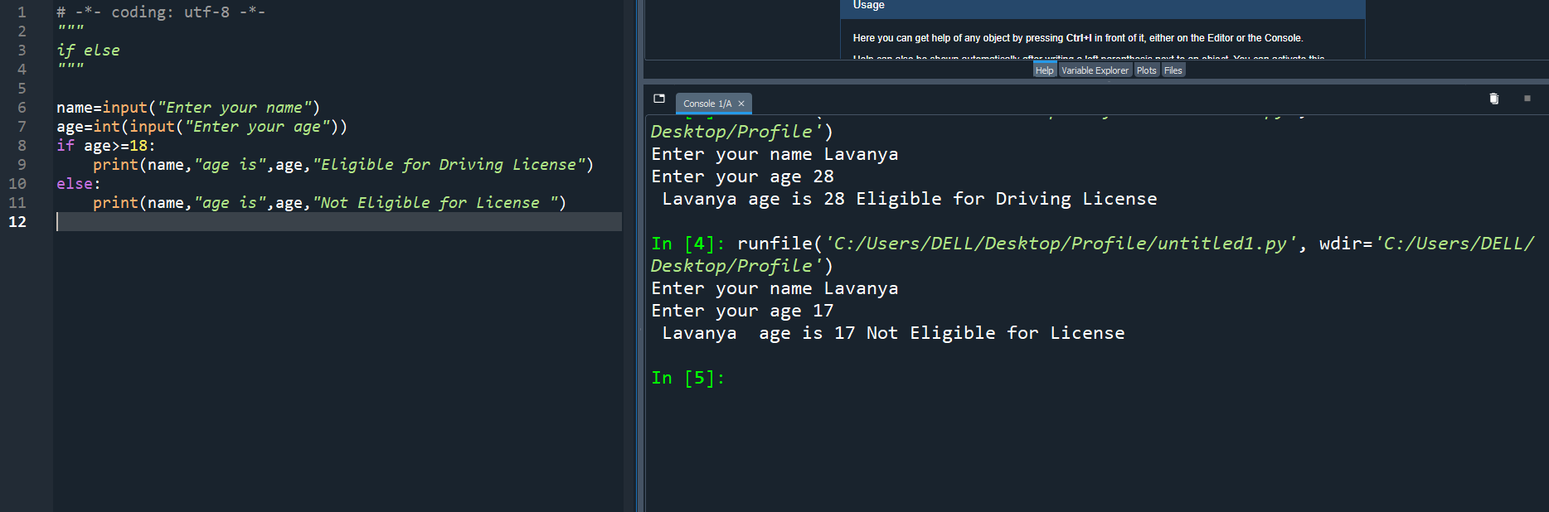
Editor Page

Slide 11
Your Task
Exercise : Get number from user and find the number Odd or Even

Slide 12
Answer
n=int(input("Enter the number"))
if n%2==0: 8%2
print(n,"is Even number")
Output
Enter the number? 12
12 is Even number

Slide 13
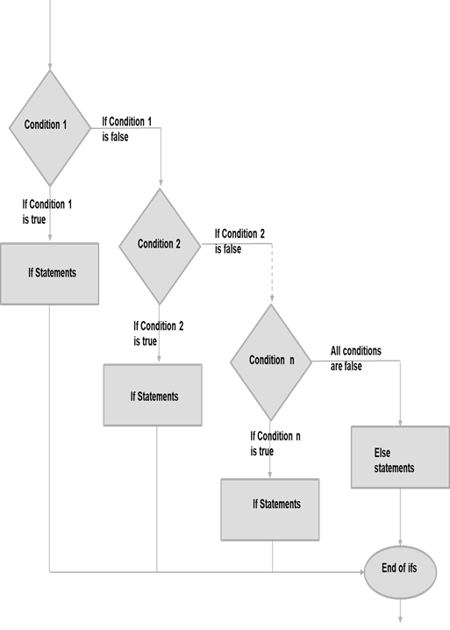
Elif Statement
Python will evalute the if condition and if it evaluates to False then it will evalute the elif blocks and execute the elif block whose expression evaluates to True. If multiple elif conditions become True, then the first elif block will be executed. The following example demonstrates if, elif, and else conditions.

Slide 14
Elif Statement
Exercise: Library Task
User going to take book from Library same day return his book no fine 1-5 days the fine amount per day 5dhrs 6-10 days fine amount 10dhrs per day 11-15 days 15 dhs per day above 15 days membership will be cancel
Fine Calculation
0=no fine
1-5 =0.5
6-10 =10
10-30=5
Above 30=membership cancel

Slide 15
Coding
days=int(input("Enter the Days"))
if (days==0):
print("Good no fine")
elif(days>=1 and days<=5):
print("Fine Amount: ",days*0.5)
elif(days>5 and days<=10):
print("Fine Amount: ",days*1)
elif(days>10 and days<=30):
print("FineAmount",days*5)
else:
print("Membership Cancel")

Slide 16
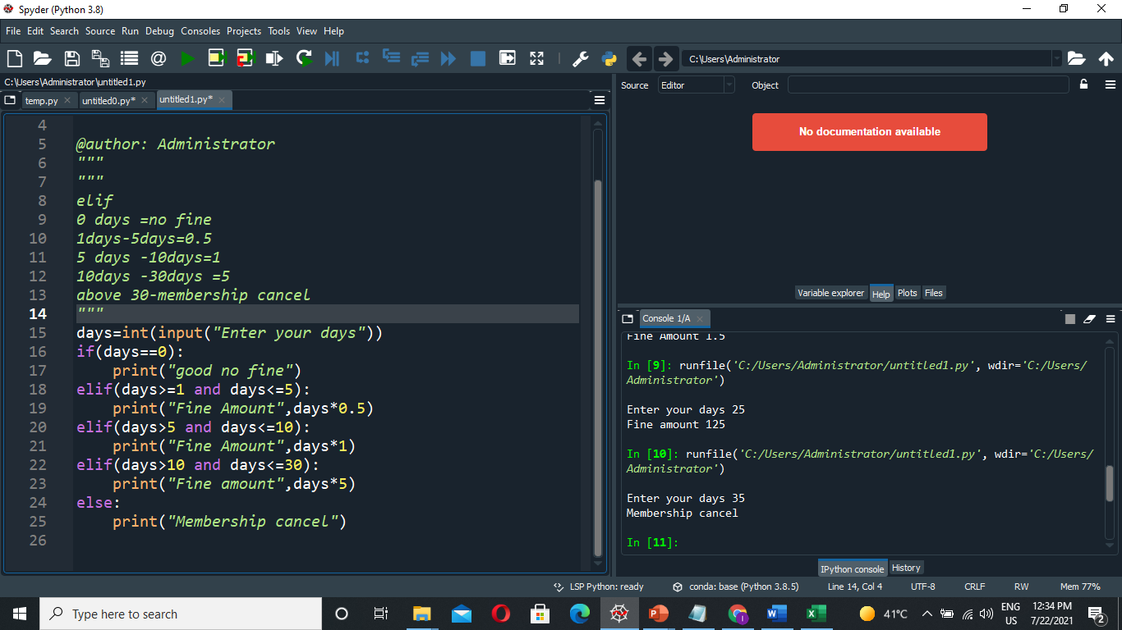
Editor Page

Slide 17
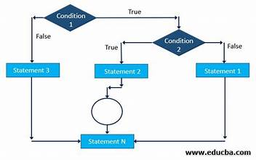
Nested If
What is a nested IF statement?
There comes a situation in real life when we need to make some decisions and based on these decisions, we decide what we should do next. Similar situations arise in programming also where we need to make some decisions and based on these decisions we choose when to execute the next block of code. This is done with the help of a Nested if statement.

Slide 18
Task :
Get 5 marks from the user and find out total, average, result and grade
5 Marks from user
Total
Average
Result
If Pass
GRADE SYSTEM
90-100=A
80-89=B
70-79=C
Else=D

Slide 19
Coding
m1=int(input("Enter first mark :"))
m2=int(input("Enter second mark :"))
m3=int(input("Enter third mark :"))
total=m1+m2+m3
avg=total/3
print("Total=",total)
print("Average=",avg)
if m1>=50 and m2>=50 and m3>=50:
print("Pass")
if avg>=90 and avg<=100:
print("Grade A")
elif avg>=80 and avg<=89:
print("Grade B")
elif avg>=70 and avg<=79:
print("Grade C")
else:
print("Grade D")
else:
print("result :Fail")
print("grade :Nograde")

Slide 20
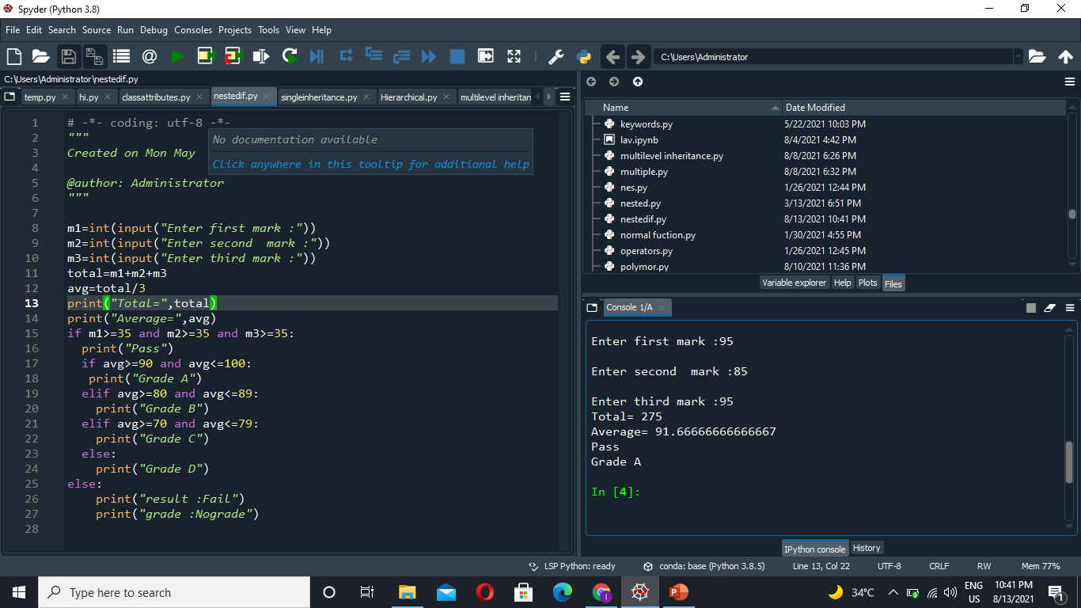

Slide 21

Online Quiz Link :
https://www.w3schools.com/python/exercise.asp?x=xrcise_conditions1
Thank You

